Slide 1
Sunshine Coast Mass Transit Action Group inc
SCRC Mass Transit Options Analysis Review
May 19th 2021

Slide 2
MTAG Who We Are
Incorporated Community Organization Commenced August 2020
Community unaware of the Mass Transit Plan
Executive Membership broad spectrum of skills:
Engineers, Business Case specialists, Lawyer, Business Professionals
Detailed analysis of all Mass Transit Literature SCRC, IA, TMR, Qld Govt
Met with and continue to liaise with all levels of Government
SC Federal MP’s
SC State MP’s (LNP and Labor)
Minister Mark Bailey’s Office
SCRC Councilors

Slide 3
MTAG Who We Are Cont…
Extensive Grass Roots Community Involvement that continues to gain momentum.
We are speaking to the community EVERYDAY!
What they say:
Don’t want Light Rail or any other fixed transport option along the coastal stretch
Don’t want increased housing density along the coastal stretch
Do want a flexible bus system that can expand as the region grows
Want CAMCOS before Mass Transit (13.6km)

Slide 4
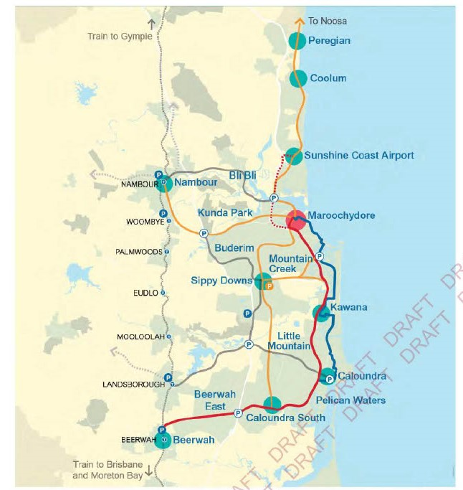
MTAG’s Position
MTAG Priority 1
Fast/heavy rail from Brisbane to Maroochydore (CAMCOS) with a modern, efficient, flexible, green, bus system connecting ALL the sunshine coast region

Slide 5
What the Community Think Sunshine Coast Daily 2018

Slide 6
What the Community Think Courier Mail 2020

Slide 7
What the Community Think MTAG Survey 2021
Which of the following Mass Transit options would you prefer to see happen on the Sunshine Coast?
Fast Rail from Maroochydore to Beerwah (via the CAMCOS corridor) integrated with a modern bus system
Light Rail initially from Maroochydore to Kawana (stage 1) then from Kawana to Caloundra (stage 2)
Neither

Slide 8
What the Community Think MTAG Survey 2021
Want a flexible bus system to support it

Slide 9
What the Community think of the 9 Options MTAG Survey 2021

Slide 10
What the Community think of the 9 Options MTAG Survey 2021
59%

Slide 11
Other Issues People are Raising

Slide 12
1.Urbanization strategy or Transport strategy?
What weighting is given to Community Choice?

Slide 13
2. Densification Levels ??????
105,000
Source: Preliminary Business Case PwC Report
Interim Findings Jan 2020

Slide 14
3. Why the Mass Transit Route doesn’t make sense
Mass transit route has a good public bus system now
600 bus
hardly used.
Why will behaviour change?

Slide 15
Existing 600 Bus Service
Proposed Mass Transit Service
600 Bus

Slide 16
26 mins

Slide 17
23 mins

Slide 18
3. Why the Mass Transit Route doesn’t make sense
LRT journey time 30mins CBD to SCUH
Approx 25 mins to Main Drive
PT usage now 2%
PT usage Business Case assumption 10%
What is going to change behaviour?

Slide 19
3. Why the Mass Transit Route doesn’t make sense
Route connects to nothing
Will not relieve congestion in other areas of the Coast..Caloundra, Buderim, Coolum, Bruce Highway
Only considers North South movements. What about East West?
Does not service major centres such as University, Airport, Buderim and Nambour medical precincts, Northern beach communities
Does not service major greenfield developments such as Aura and Beerwah East
Does not alleviate the need for a car
Located in flood and coastal hazards zone. No mention of disaster recovery plan
Gradient of the Alex Hill an issue for LRT, wLRT and maybe TT

Slide 20
4. Culturally and Socially not right for the Region
Contrary to existing character: currently low-medium density
Erosion of existing residents amenity (bought because it is low rise)
Forces long term residents from existing homes (unable to buy back in)
Could worsen housing affordability. Coastal housing affordable?
Residents consider anything over 3 stories “high-rise”
Don’t want over looking and shading of backyards
Mistrust of planning scheme to deliver community expectations

Slide 21
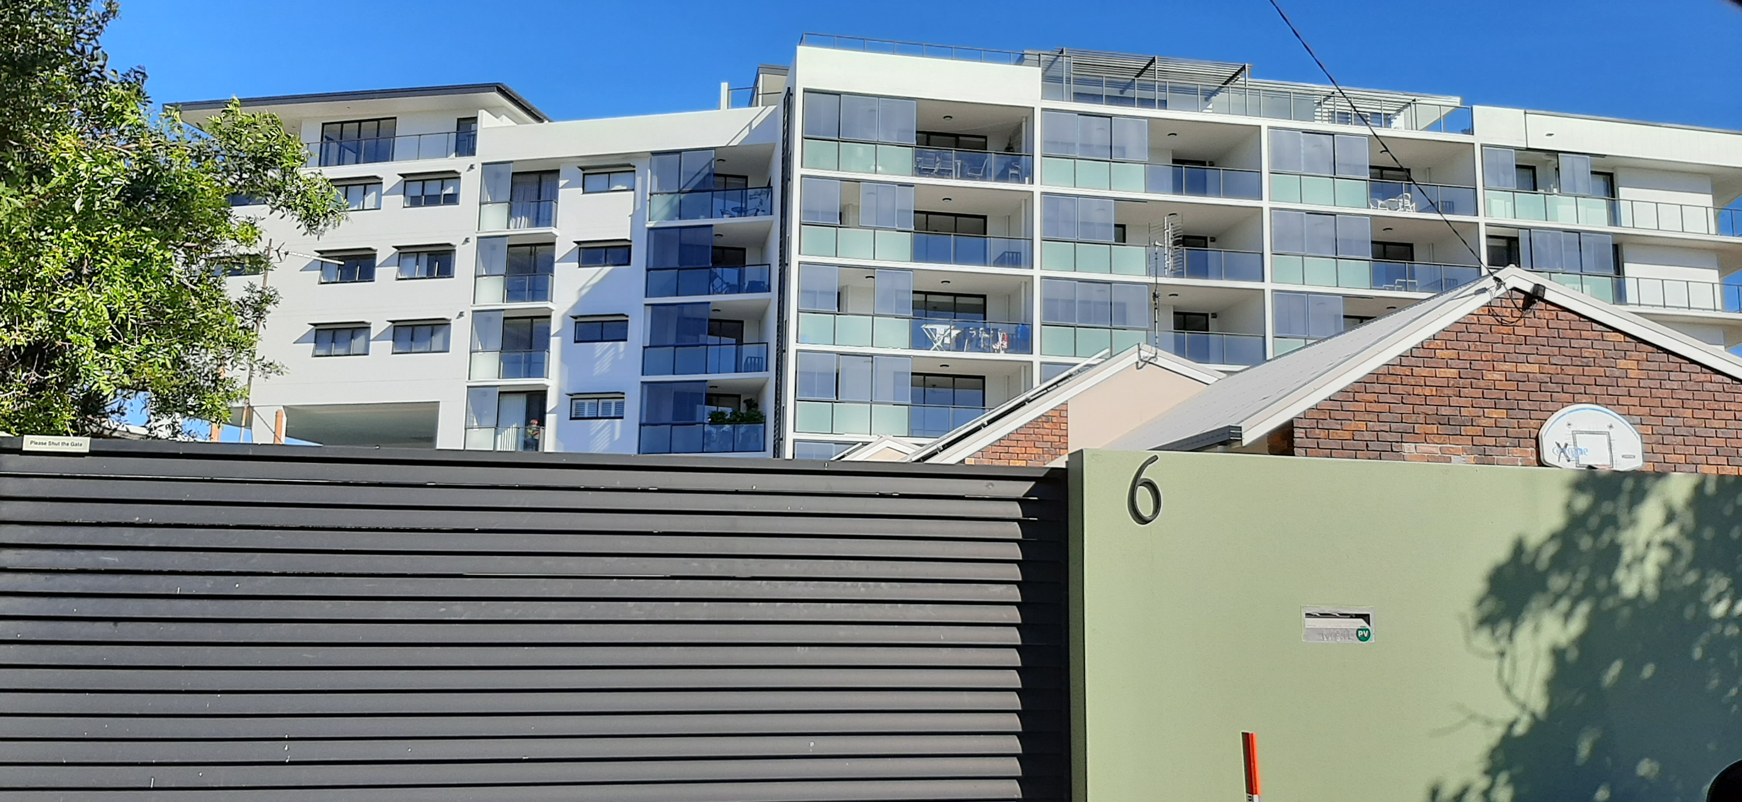
Happening Now!
6. Culturally and Socially not right for the Region

Slide 22
Happening Now!

Slide 23
Happening Now!

Slide 24
4. Culturally and Socially not right for the Region
How will the coastal corridor residential character be preserved?
How will the biodiversity of the coastal corridor be preserved?
No clear plans to upgrade hospitals, schools, sewage systems, waste systems, and telecommunications to support higher densities
Densification (2024) likely to come before transport solution(2027). New arrivals establish car usage behaviour early

Slide 25
Community Issues with Consultation
Only consulting on Draft Options Report – not what the community want to see.
Community expecting to choose priority
Community expecting to choose range of transport options
Survey perceived as biased
No indication of actual densities planned
Survey long, complicated and technical issues
Responder drop out occurring
Misleading imagery (GC all softening features removed)

Slide 26
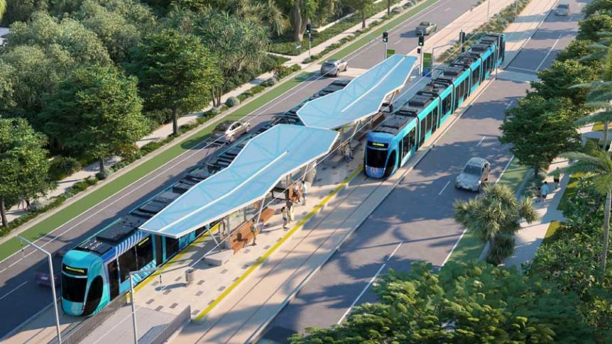
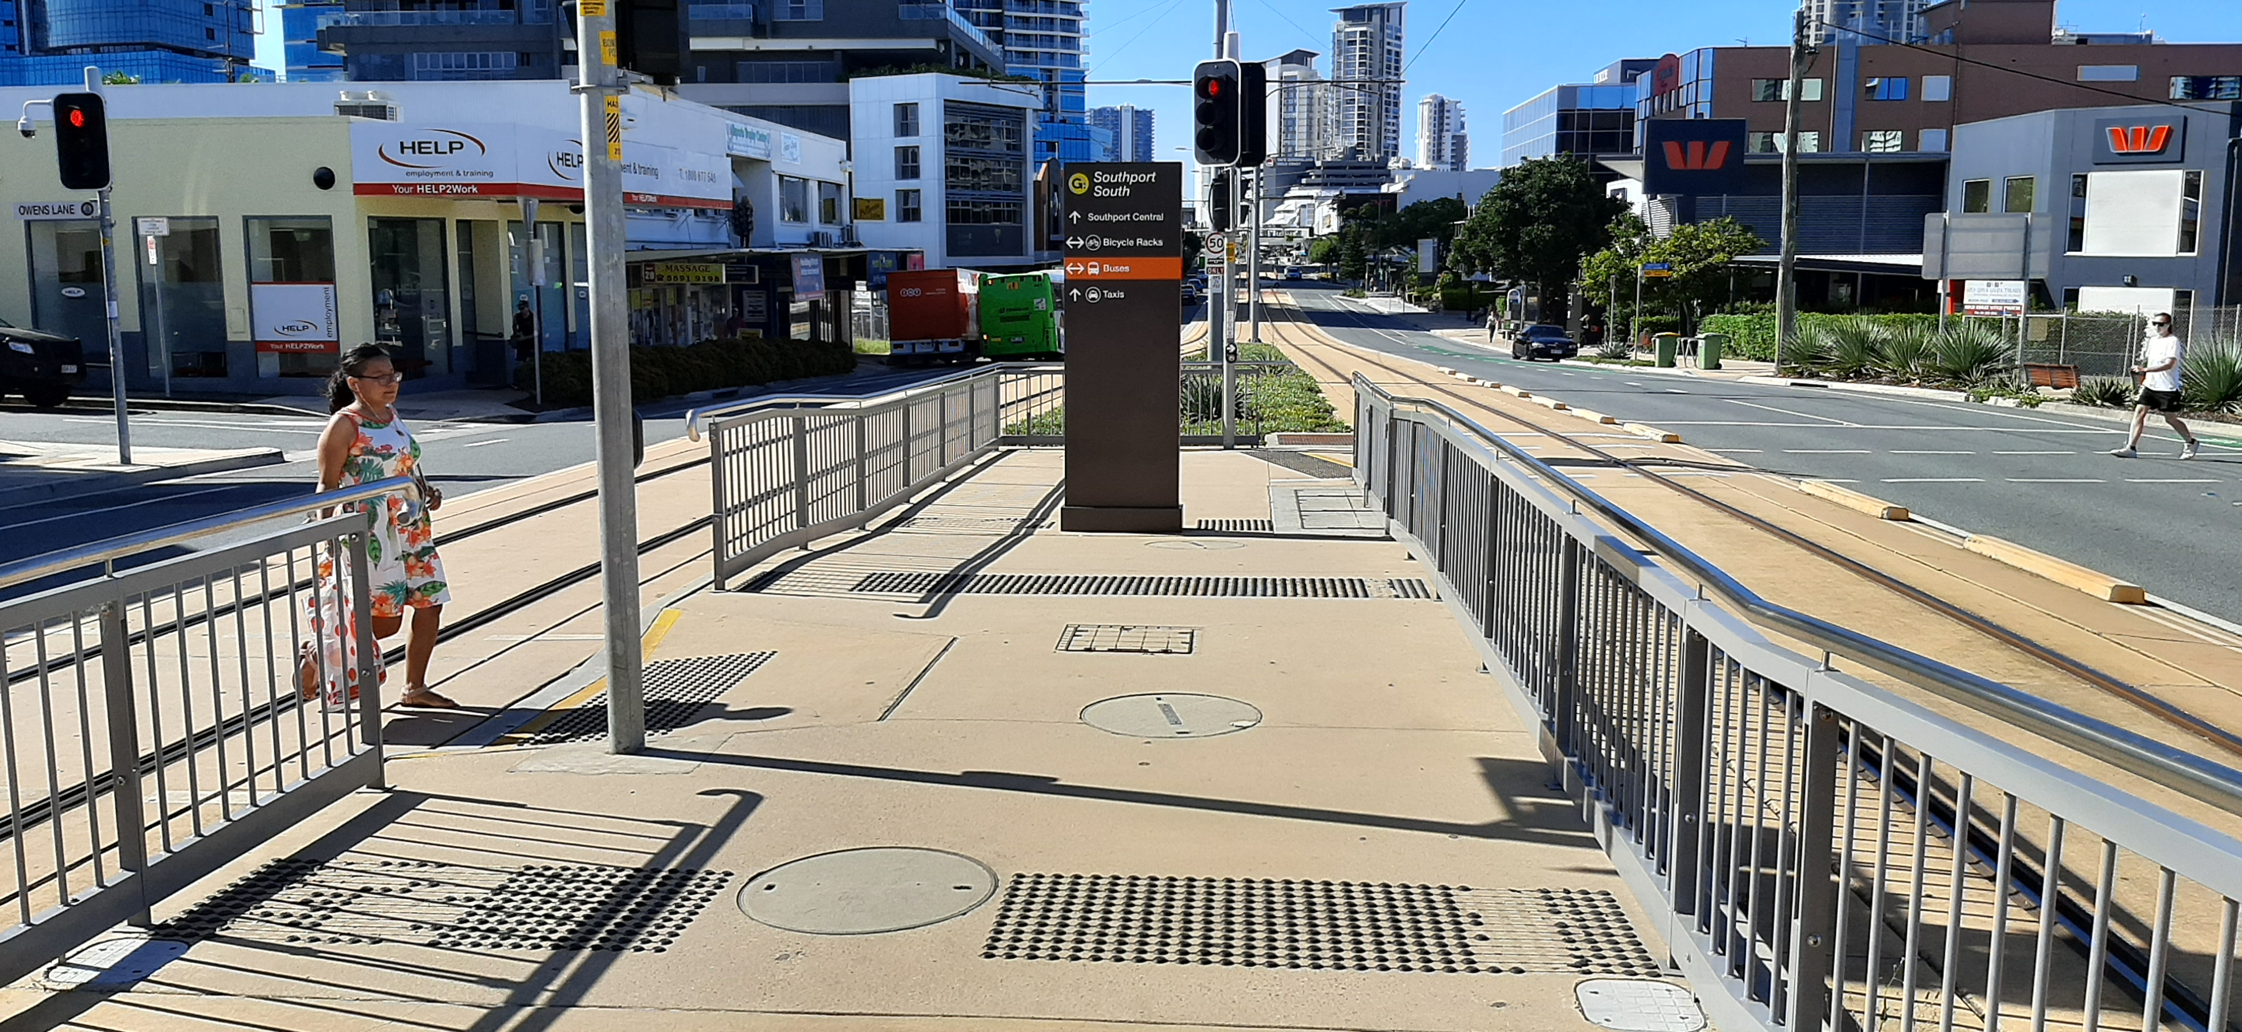
Concept images V Gold Coast Reality

Slide 27
Community Issues with Consultation cont….
Unclear how consultation will be incorporated into final recommendations?
Will the criteria be changed?
Will the priority be changed?
Will the options be changed?
Will the community be listened to?

Slide 28
In Conclusion…
The community want a transport solution for the whole region.
The chosen priority route is not what the community want or need.
The “options” are not what the community want.
LRT remains the preference due to the Business Case methodology used
Too much weighting given to densification as justification

Slide 29
In Conclusion…
The level of densification is an issue because the community do not TRUST the planning scheme
Will change the character of the area forever
Threatens existing resident’s amenity
The benefits do not outweigh the social and financial cost
Does not benefit the whole of the region
Does not have all levels of government support
Options Analysis Needs to be re-thought.

Slide 30
In Conclusion…
Thank You

